Slide 1
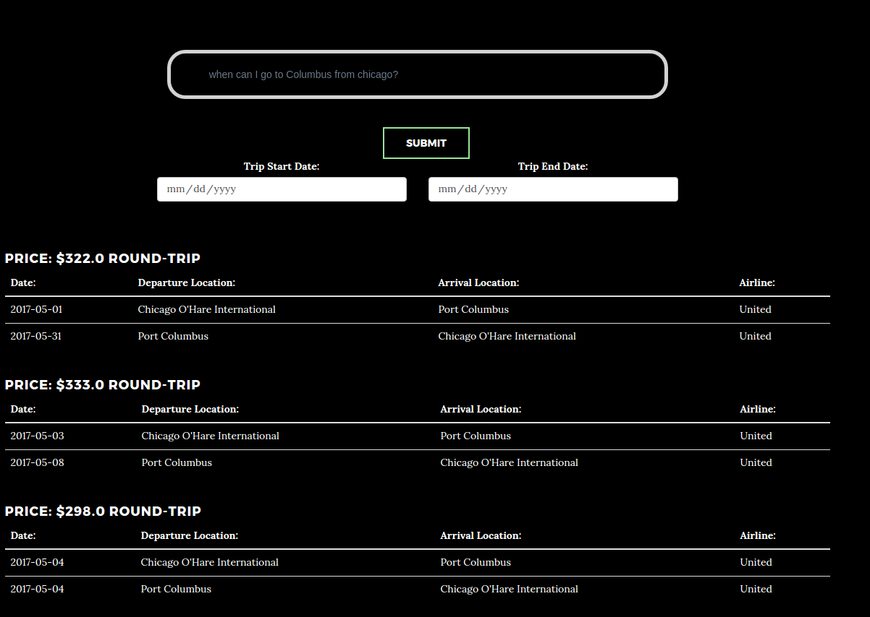
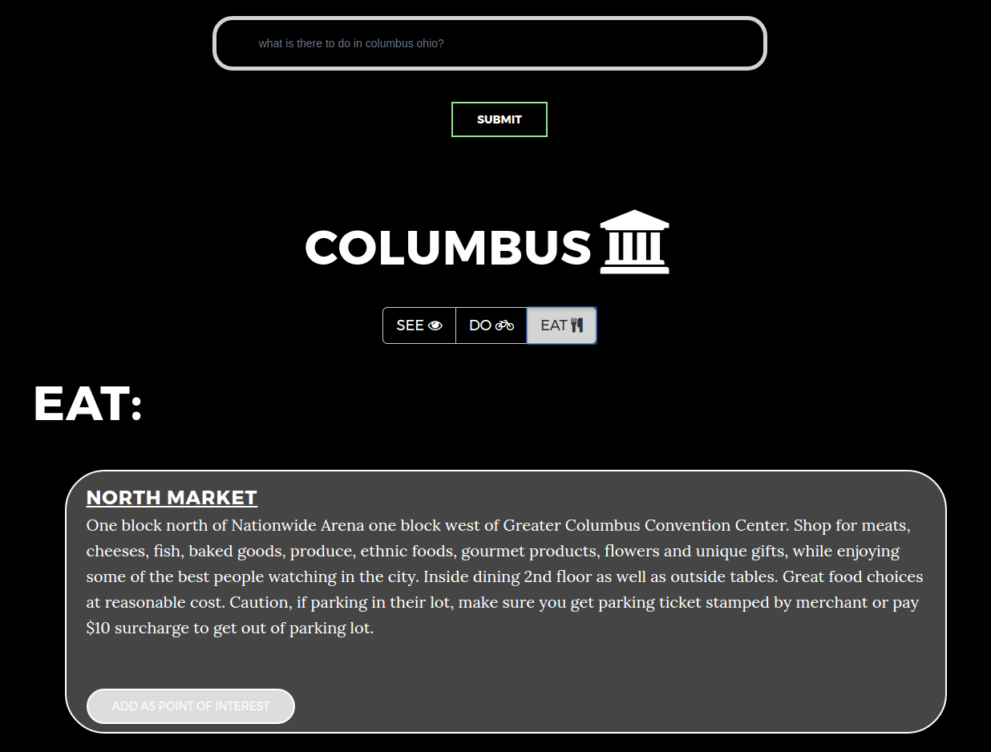
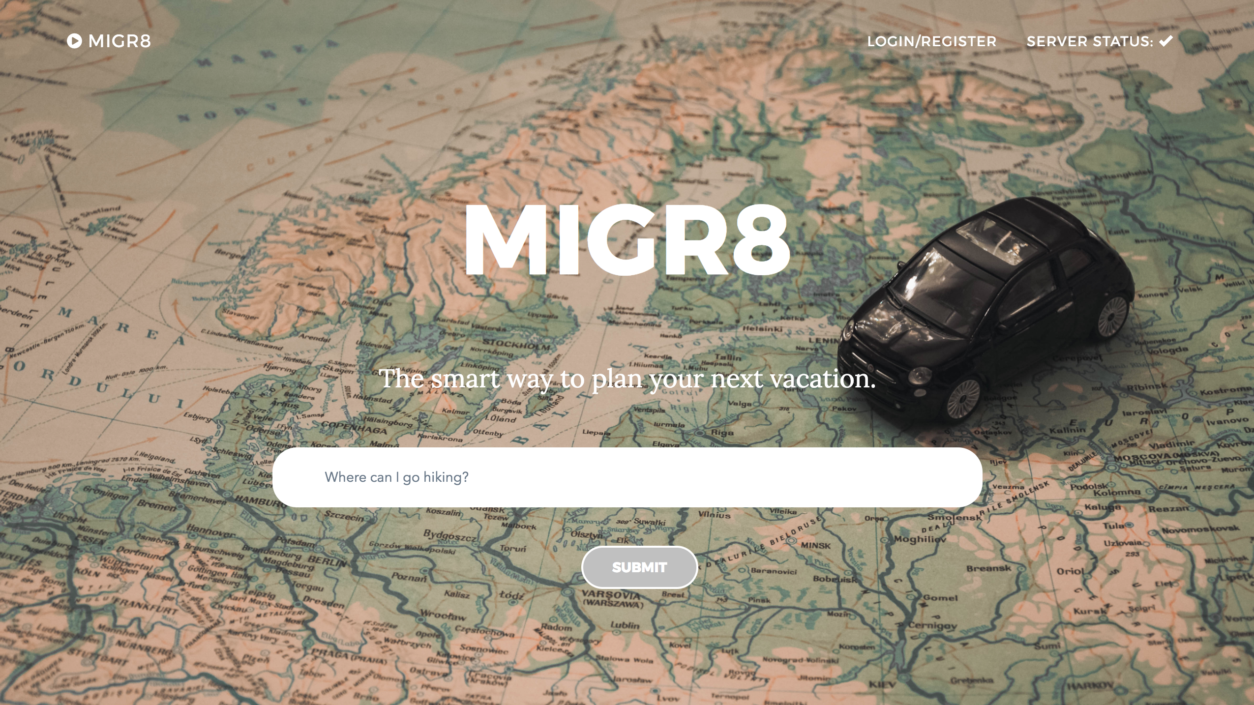
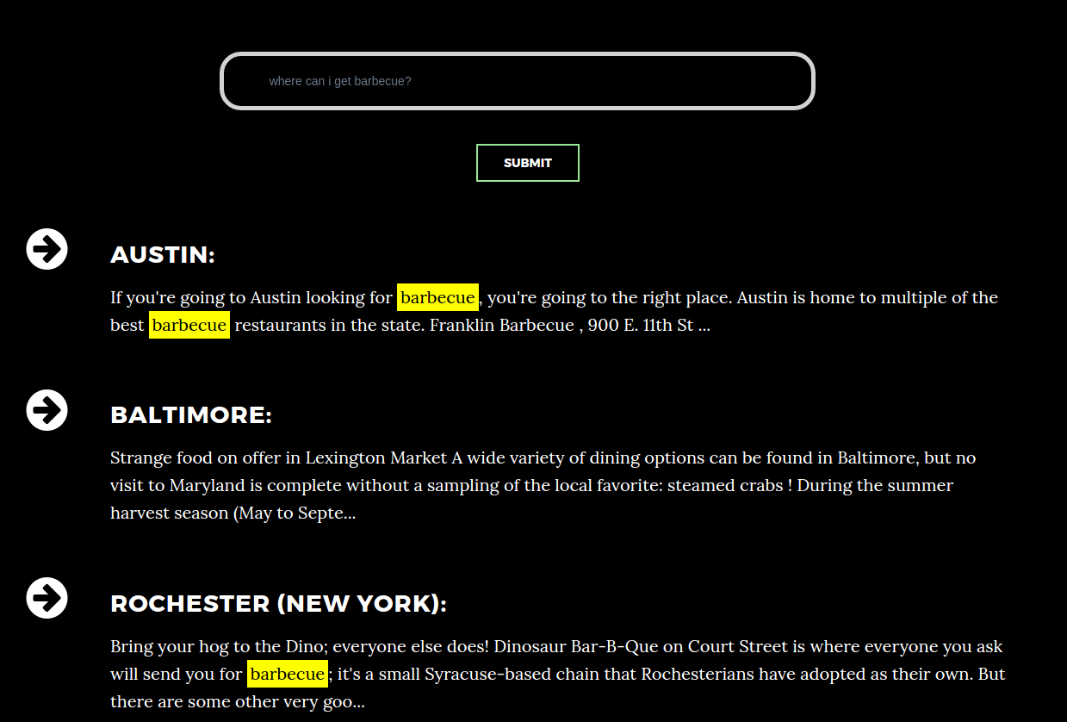
MIGR8: An Intelligent Online Travel Agent
Daniele Bellutta, Cameron Long, Sam Farren, Kamari Wright
–
Department of Computer Science & Engineering
ABSTRACT
Everyone needs a break sometimes from their daily responsibilities, but planning such trips requires a lot from people who just want to get away from work. Not everyone is an expert on the best destinations, so in planning a trip it is very easy to miss out on the most enjoyable places to visit. MIGR8 changes that by offering a platform for rediscovering the world. Users can ask questions about where to go based on their preferences and receive personalized suggestions on interesting attractions at those locations, all through natural language interactions. MIGR8 makes finding trip destinations easy and engaging.
METHODS
Front-End Web Application
The web application was built on the Django Web Framework, which runs on Python. JavaScript, HTML, and CSS were also used for creating the front-end views.
Back-End Watson Services
The back-end uses several IBM Watson services to answer user queries.
The Watson Natural Language Classifier was set up to separate queries into three classes: asking for information about where to find specific things or do specific activites, asking for information about a specific city, and asking for information on flights between two cities.
The application used two clusters of Watson Retrieve and Rank: one for holding files on the attractions in a city and one for keeping chunks of general data on cities.
Watson Natural Language Understanding was used for two purposes: highlighting search terms in user queries and identifying cities in user queries regarding flight schedules.
The Skyscanner API was used for two purposes: acquiring flight schedules and completing city names in user queries.
Flight Schedules and Quotes
City Results
PROBLEM
Planning a trip can be a difficult, involved process. Even just deciding where to go can be problematic. Tourists often resort to simply going to well-known hotspots and seeing famous attractions, often by-passing lesser-known towns and activities. Many people miss out on the attractions that might interest them the most, just because they are not aware they exist. In order to be comprehensive in planning a trip, people currently have to use several different resources and websites to make sure that they have explored all of their options.
Asking when one can travel somewhere or how much it costs to go to a place will bring up a list of available flights and their respective costs.
Asking for information on a specific city presents results on attractions at that location. Users who are logged in have the option of adding attractions to a list of points of interest tied to their account.
RESULTS
Features
Users can query a collection of articles to get results on the ideal location to do a certain activity (e.g., hiking) or find a specific thing (e.g., good music)
Users can query a second collection to get information on what activities are available in a certain city, separated into separate “see,” “do,” and “eat” sections
Allows users to search for available flights between specified cities on specific dates given by the user
Maintains a search history for signed-in users, allowing them to recall recent queries they have performed
Maintains a list of points of interest that users can add or delete as they wish
See – Do – Eat
MIGR8 presents information in an innovative three-part categorization:
See: attractions, museums, parks, etc.
Do: activities, cinemas, concert halls, etc.
Eat: restaurants, cafès, bakeries, etc.
CONCLUSIONS
As an application, MIGR8 provides one place where people can find recommended destinations based on their interests, discover intriguing attractions in specific cities, and view flight schedules and costs. As a service, MIGR8 has the potential to resolve many of the issues experienced by travelers in the modern era. MIGR8 users can explore the world around them based on their own passions and unearth places and attractions that were previously unknown to them. For this reason, rather than being a search engine devoted to vacationing, MIGR8 is a true exploration engine with which users can uncover new and interesting places in the world around them.
MIGR8 Homepage
Destination Recommendations
ACKNOWLEDGEMENTS
Dr. Stephen Boxwell provided invaluable guidance during the entire process of creating MIGR8. IBM graciously provided its Watson services to be used for the project. Wikivoyage.org graciously provided the data on city attractions and on general city characteristics. Skyscanner was used to provide flight schedules and quotes.
The MIGR8 homepage lets users search for destination recommendations, attractions in U.S. cities, and flights to specific places. Loading the homepage auto-populates the search field with a random sample question to give users an idea of MIGR8’s capabilities.
Asking where something can be done or found results in a list of recommended cities and corresponding text descriptions.
Spring 2017

